Slide 1
PRIORITY BASED ROUND ROBIN
Atul Agarwal | Manav Nanwani | Mohammad Ayaaz | Priyanshu Gupta

Slide 2
OBJECTIVE
Minimizing turn around time and Waiting time
Implement Algorithm for both, Pre-emptive and Non Pre-emptive Cases
Implementing the concept of Priority based Scheduling.

Slide 3
ABSTRACT
This project tries to overcome the drawbacks of Priority Based CPU Scheduling System and Round Robin CPU Scheduling System by combining the two and maintaining the advantages of both. The project will implement at least 2 algorithms, one considering arrival time and one without it. The objective will be to make time quantum dynamic and reduce the average turn around and waiting time.

Slide 4
INTRODUCTION
Modern operating systems depend highly on CPU Scheduling systems to improve multitasking and multiprogramming. There exist multiple CPU Scheduling algorithms such as First Come First Serve (FCFS), Shortest Job First (SJF), Round-Robin, and Priority-based. Out of these RR and Priority-based are the most frequently used and relied on. However, they too have their own drawbacks. By combining these two and using a dynamic time quantum whenever possible we try to reduce turnaround time and waiting time.

Slide 5
PROBLEMS WITH CURRENT ALGORITHM
Lower time quantum results in higher the context switching overhead in the system.
If high priority processes take lots of CPU time, then the lower priority processes may starve and will be postponed for an indefinite time.
These scheduling algorithms may leave some low priority processes waiting indefinitely.
A process will be blocked when it is ready to run but has to wait for the CPU because some other process is running currently.
If a new higher priority process keeps on coming in the ready queue, then the process which is in the waiting state may need to wait for a long duration of time.
In cases with low time quantum the TAT and WT are usually high.
Round-robin scheduling doesn't give special priority to more important tasks.

Slide 6
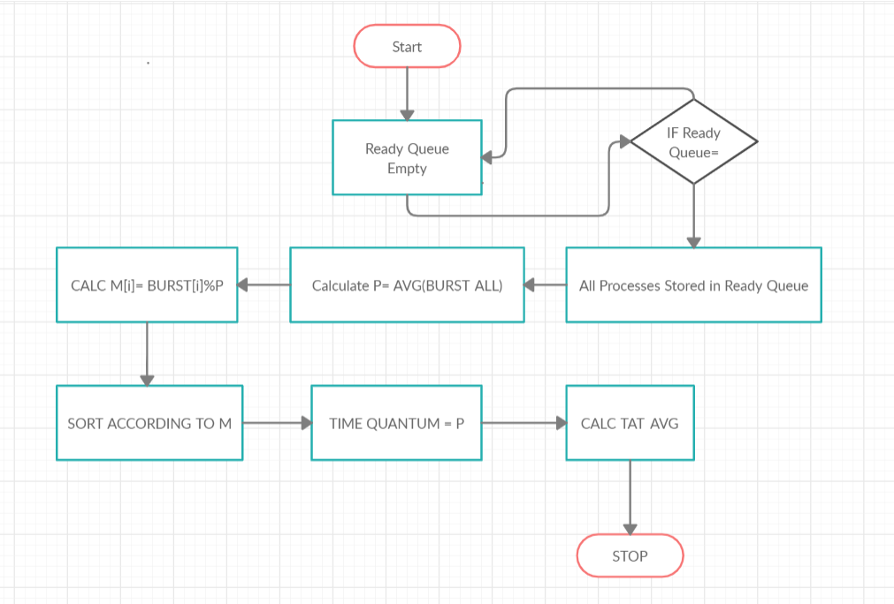
ALGORITHM - (Non-preemptive)

Slide 7
METHODOLOGY
For Non-Preemptive 1:
The method would be to calculate Time Quantum (TQ), using the average of burst time of all processes.
The priority for each process P[i] would then be evaluated using BT[i]%TQ.
All the processes are added to the ready queue on bases of their priority and sorted in ascending order and then evaluated using Round Robin CPU Scheduling using the new time quantum(TQ) calculated.
We expect a lower number of context switches and lower average waiting times and lower average turnaround times.

Slide 8
NON-PREEMPTIVE 2
The method would be to calculate Time Quantum (TQ), using the average of burst time of all processes.
The priority for each process P[i] would then be evaluated using BT[i]%TQ.
All the processes are added to the ready queue on bases of their priority and sorted in descending order and then evaluated using Round Robin CPU Scheduling using the new time quantum(TQ) calculated.
We expect a lower number of context switches and lower average waiting times and lower average turnaround times.

Slide 9
NON-PREEMPTIVE 3
The method would be to calculate Time Quantum (TQ), using the average of burst time of all processes.
The new priority for each process P[i] would then be evaluated using BT[i]*PRI[i], with existing priority that is provided by user.
All the processes are added to the ready queue on bases of their priority and sorted in ascending order and then evaluated using Round Robin CPU Scheduling using the new time quantum(TQ) calculated.
We expect a lower number of context switches and lower average waiting times and lower average turnaround times.

Slide 10
NON-PREEMPTIVE 4
The method would be to calculate Time Quantum (TQ), using the average of burst time of all processes.
The priority for each process P[i] would then be evaluated using BT[i].
All the processes are added to the ready queue on bases of their priority and sorted in ascending order and then evaluated using Round Robin CPU Scheduling using the new time quantum(TQ) calculated.
We expect a lower number of context switches and lower average waiting times and lower average turnaround times.

Slide 11
TEST CASES: NON PREEMPTIVE
PROCESS ID | BURST TIME
P1 | 23
P2 | 12
P3 | 9
P4 | 10
P5 | 16
TYPE | 1 | 2 | 3 | 4
AVG. TAT | 45.599 | 43.400 | 48.799 | 38.00
AVG WT | 31.666 | 29.400 | 34.799 | 24.00

Slide 12
TEST CASES: NON PREEMPTIVE
PROCESS ID | BURST TIME
P1 | 10
P2 | 8
P3 | 2
P4 | 6
P5 | 9
P6 | 12
TYPE | 1 | 2 | 3 | 4
AVG TAT | 30.66 | 32.00 | 28.33 | 29.166
AVG WT | 22.833 | 24.166 | 20.5 | 21.333

Slide 13
TEST CASES: NON PREEMPTIVE
PROCESS ID | BURST TIME
P1 | 20
P2 | 15
P3 | 10
P4 | 5
P5 | 25
TYPE | 1 | 2 | 3 | 4
AVG. TAT | 41.00 | 52.00 | 48.00 | 38.00
AVG WT | 26.00 | 37.00 | 33.00 | 23.00

Slide 14
TEST CASES: NON PREEMPTIVE
PROCESS ID | BURST TIME
P1 | 5
P2 | 3
P3 | 1
P4 | 2
P5 | 3
TYPE | 1 | 2 | 3 | 4
AVG. TAT | 5.2 | 7.00 | 7.4 | 7.800
AVG WT | 8.00 | 9.800 | 10.2 | 5.00

Slide 15
TEST CASES: NON PREEMPTIVE
PROCESS ID | BURST TIME
P1 | 5
P2 | 6
P3 | 7
P4 | 9
P5 | 2
P6 | 3
TYPE | 1 | 2 | 3 | 4
AVG TAT | 17.66 | 17.00 | 17.67 | 17.166
AVG WT | 12.33 | 22.33 | 23.00 | 11.833

Slide 16
TEST CASES: NON PREEMPTIVE
PROCESS ID | BURST TIME
P1 | 4
P2 | 5
P3 | 2
P4 | 1
P5 | 6
P6 | 3
TYPE | 1 | 2 | 3 | 4
AVG TAT | 12.833 | 13.66 | 10.5 | 10.8333
AVG WT | 9.33 | 10.166 | 14.00 | 7.333

Slide 17
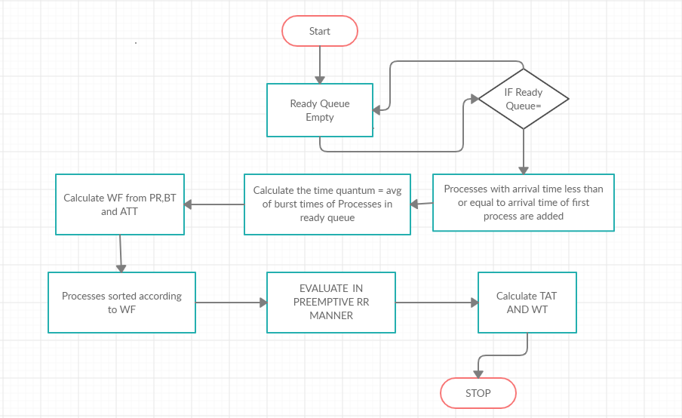
ALGORITHM - (Preemptive)

Slide 18
METHODOLOGY
For Preemptive 1:
For a preemptive system, the time quantum would have to be dynamic. It would alter at the arrival of each new process.
The time quantum would be calculated as the sum of (all remaining burst times/number of processes). Priority for a process would be calculated using a formula specified as WF = (PR*0.8) + (BT*0.7) + (ATT * 0.2).
Where PR is specified priority, BT is burst time for that process and ATT is the arrival time for the process.

Slide 19
PREEMPTIVE 1 (Continued)
Arrange processes in increasing order wrt their WF. When two processes have the same WF consider the priority for arranging.
Calculate the Time Quantum, for processes in the ready queue.
Assign TQ to process: Pi ->TQ
If a new process arrives then update the counter and iterate again

Slide 20
PREEMPTIVE 2
For a preemptive system, the time quantum would have to be dynamic. It would alter at the arrival of each new process.
The time quantum would be calculated as the sum of (all remaining burst times/number of processes). Priority for a process would be calculated using a formula specified as WF = (PR*0.8) + (BT*0.7) + (ATT * 0.2).
Where PR is specified priority, BT is burst time for that process and ATT is the arrival time for the process.

Slide 21
PREEMPTIVE 2 (Continued)
Arrange processes in decreasing order wrt their WF. When two processes have the same WF consider the priority for arranging.
Calculate the Time Quantum, for processes in the ready queue.
Assign TQ to process: Pi ->TQ
If a new process arrives then update the counter and iterate again

Slide 22
PREEMPTIVE 3
For a preemptive system, the time quantum would have to be dynamic. It would alter at the arrival of each new process.
The time quantum would be calculated as the sum of (all remaining burst times/number of processes). Priority for a process would be it’s BURST TIME.
Arrange processes in increasing order wrt their WF. When two processes have the same WF consider the priority for arranging.

Slide 23
PREEMPTIVE 3 (Continued)
Calculate the Time Quantum, for processes in the ready queue.
Assign TQ to process: Pi ->TQ
If a new process arrives then update the counter and iterate again

Slide 24
PREEMPTIVE 4
For a preemptive system, the time quantum would have to be dynamic. It would alter at the arrival of each new process.
The time quantum would be calculated as the sum of (all remaining burst times/number of processes). Priority for a process would be the product of it’s BURST TIME and ARRIVAL TIME.
Arrange processes in increasing order wrt their WF. When two processes have the same WF consider the priority for arranging.

Slide 25
PREEMPTIVE 4 (Continued)
Calculate the Time Quantum, for processes in the ready queue.
Assign TQ to process: Pi ->TQ
If a new process arrives then update the counter and iterate again

Slide 26
TEST CASES: PREEMPTIVE
PROCESS ID | ARRIVAL TIME | BURST TIME | PRIORITY
P1 | 0 | 5 | 1
P2 | 1 | 3 | 2
P3 | 2 | 1 | 3
P4 | 3 | 2 | 4
P5 | 4 | 3 | 5
TYPE | 1 | 2 | 3 | 4
AVG TAT | 7.600 | 8.600 | 7.200 | 7.600
AVG WT | 4.800 | 5.600 | 4.400 | 4.800

Slide 27
TEST CASES: PREEMPTIVE
PROCESS ID | ARRIVAL TIME | BURST TIME | PRIORITY
P1 | 0 | 4 | 1
P2 | 1 | 5 | 2
P3 | 2 | 2 | 3
P4 | 3 | 1 | 4
P5 | 4 | 6 | 5
P6 | 6 | 3 | 6
TYPE | 1 | 2 | 3 | 4
AVG TAT | 9.500 | 12.00 | 9.666 | 9.33
AVG WT | 6.00 | 8.50 | 6.166 | 5.833

Slide 28
TEST CASES: PREEMPTIVE
PROCESS ID | ARRIVAL TIME | BURST TIME | PRIORITY
P1 | 5 | 5 | 1
P2 | 4 | 6 | 2
P3 | 3 | 7 | 3
P4 | 1 | 9 | 4
P5 | 2 | 2 | 5
P6 | 6 | 3 | 6
TYPE | 1 | 2 | 3 | 4
AVG TAT | 21.833 | 20.00 | 22.000 | 25.500
AVG WT | 16.500 | 22.66 | 16.66 | 20.166

Slide 29
TEST CASES: PREEMPTIVE
PROCESS ID | ARRIVAL TIME | BURST TIME | PRIORITY
P1 | 0 | 40 | 1
P2 | 1 | 20 | 2
P3 | 2 | 10 | 3
P4 | 3 | 15 | 4
P5 | 4 | 5 | 5
TYPE | 1 | 2 | 3 | 4
AVG TAT | 60 | 72 | 60 | 61
AVG WT | 42 | 54 | 42 | 42.6

Slide 30
CONCLUSION
For Non Preemptive:
In most of our test cases the best turnaround time and the waiting time were lowest for our algorithm where the processes were sorted in ascending order of their burst times and the time quantum was assumed to be the average of all the burst times given.
Hence we can conclude that the proposed algorithm is better than the existing Non-Preemptive Algorithm.

Slide 31
CONCLUSION
For Preemptive:
Here too in most cases the algorithm which provided the best turnaround time and waiting time was the one where processes (in ready queue) were prioritised according to the burst time and sorted in increasing order.
Hence we can conclude that the proposed algorithm is better than the existing Preemptive Algorithm.

Slide 32
Final Conclusion
After looking at the test cases of both preemptive and non preemptive algorithms that we considered, we conclude that the better algorithm for Round Robin CPU Scheduling is to
i) sort the processes in increasing order on the bases of their burst time
ii) to take a time quantum equal to the average of the burst of all present in the ready queue.

